Slide 1
Connection Angular Application connecting to backend express with mongo db– Step 14

Slide 2
Backend module
First you make sure backend application running using nodemon or node with rest api connected with mongo db database.
So we will use step step 13 which is running backend module with express js with mongo db database.

Slide 3
Create angular project using ng command
ng new frontend
It will ask you routing → Yes
Styling → css

Slide 4
Open the angular project in vs code
Now create the
ng generate component product
ng generate service product
ng generate class product

Slide 5
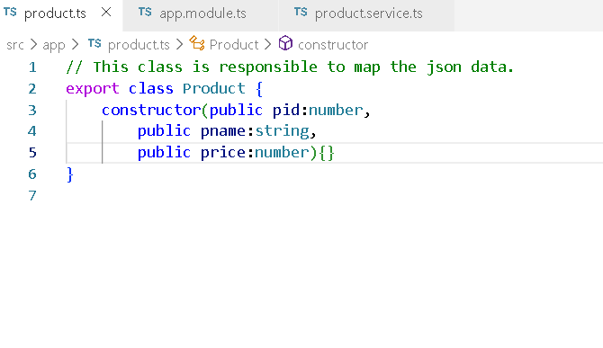
product.ts model file

Slide 6
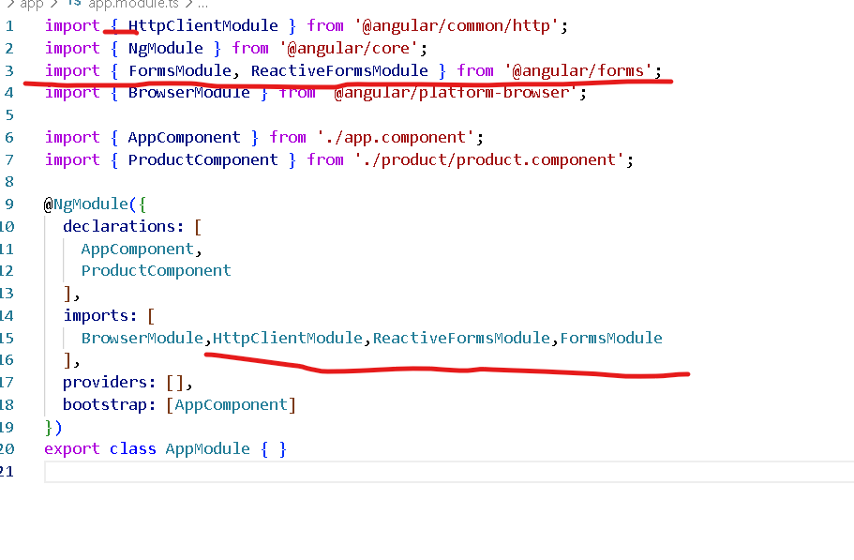
app.module.ts file all required modules

Slide 7
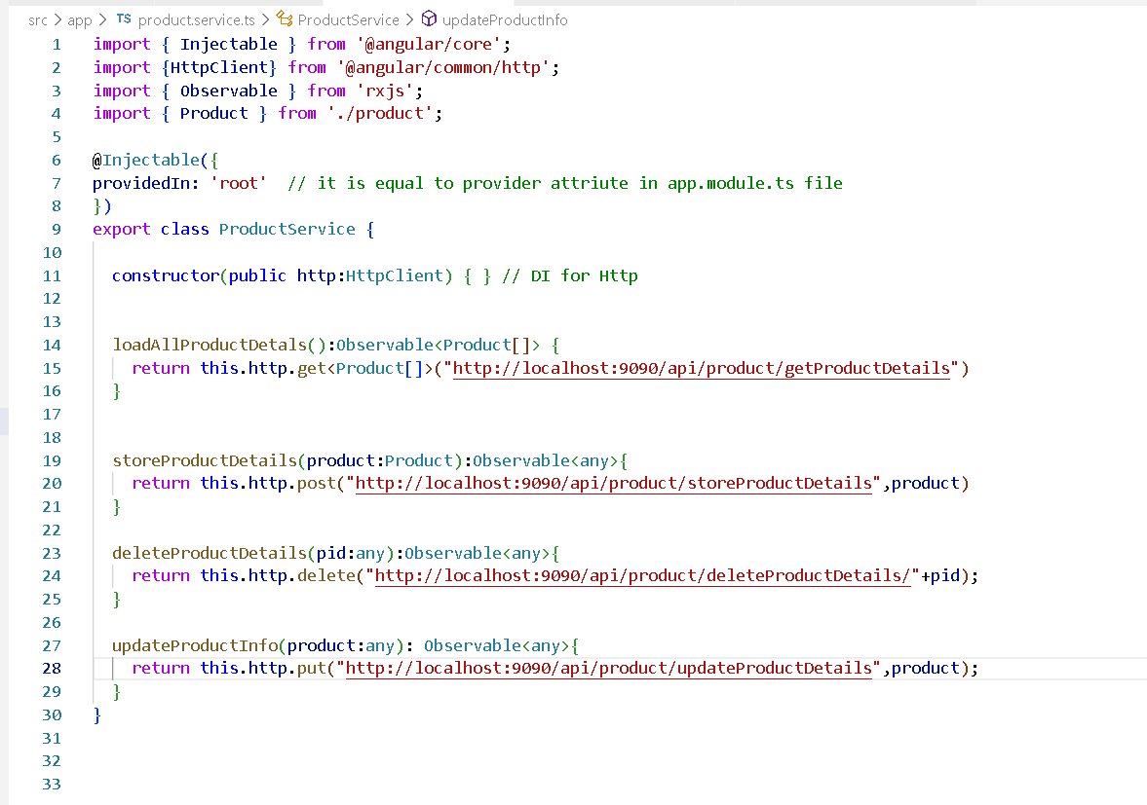
product.service.ts file

Slide 8
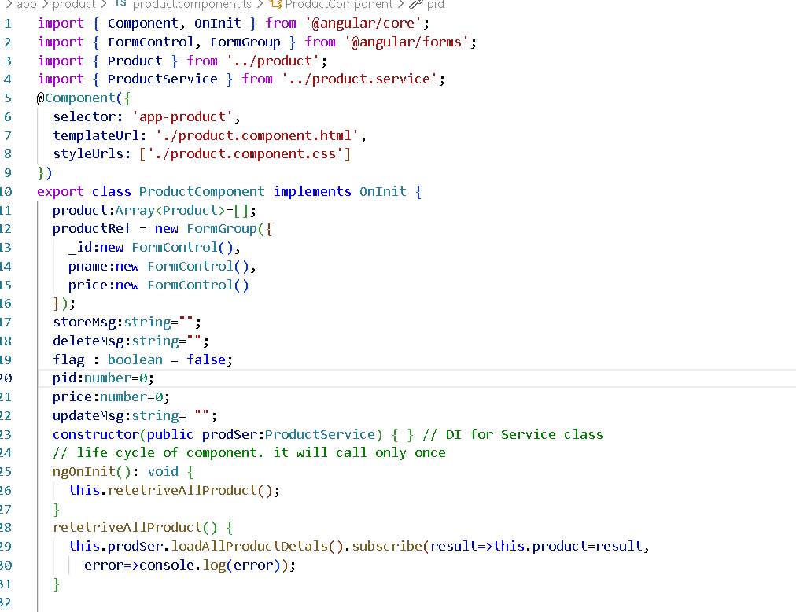
app.product.ts

Slide 9
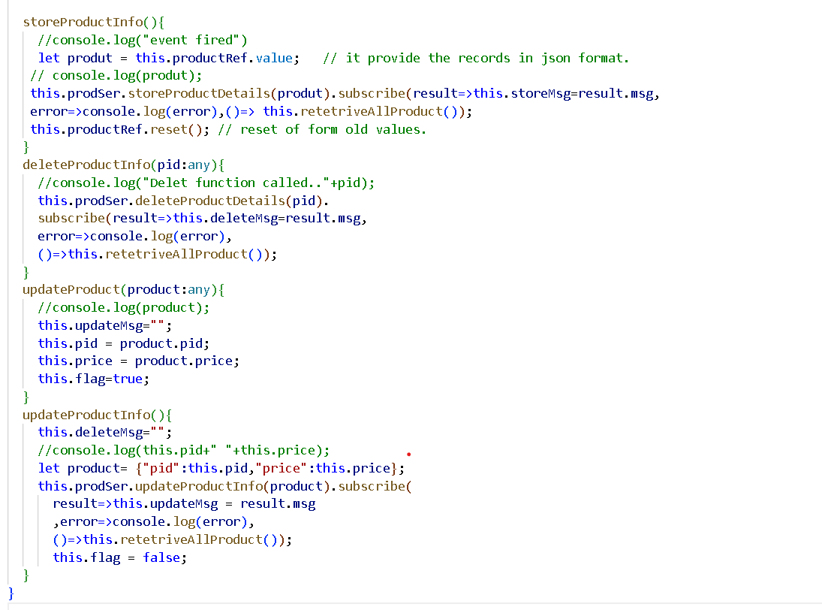

Slide 10
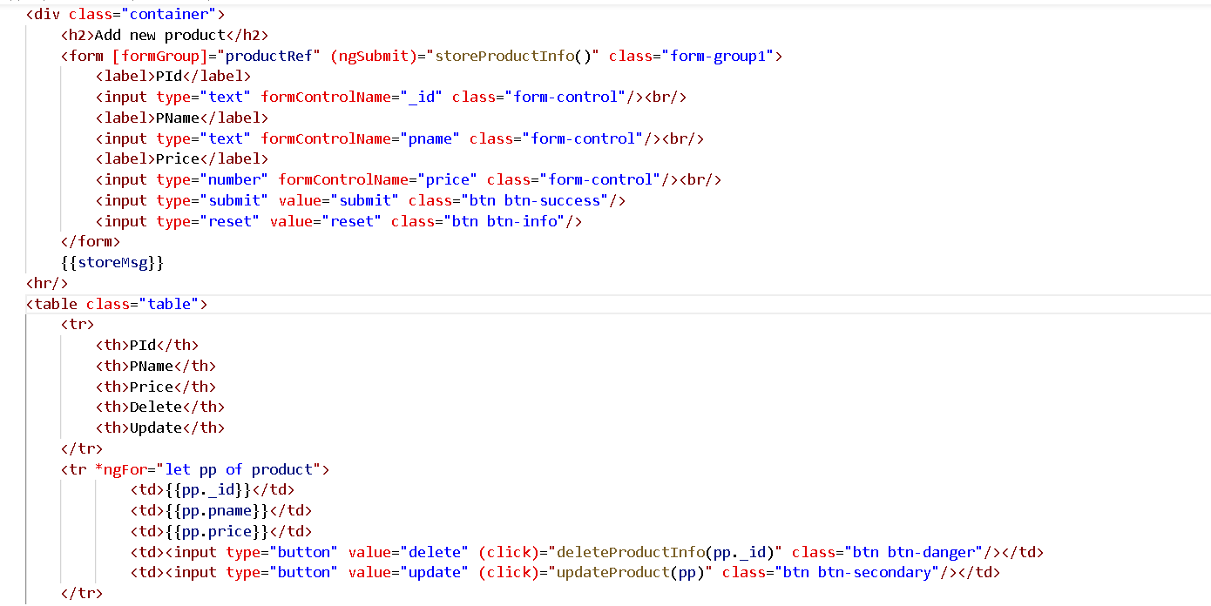

Slide 11
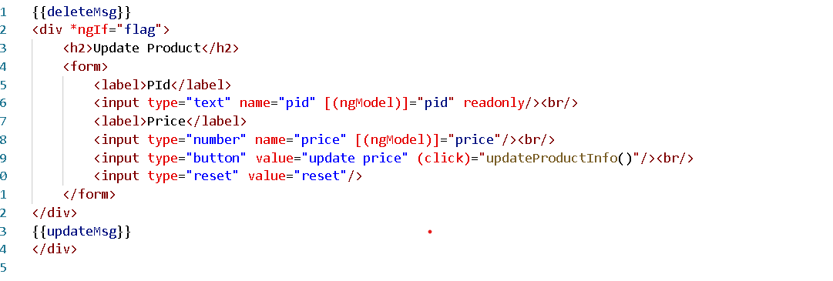

Slide 12
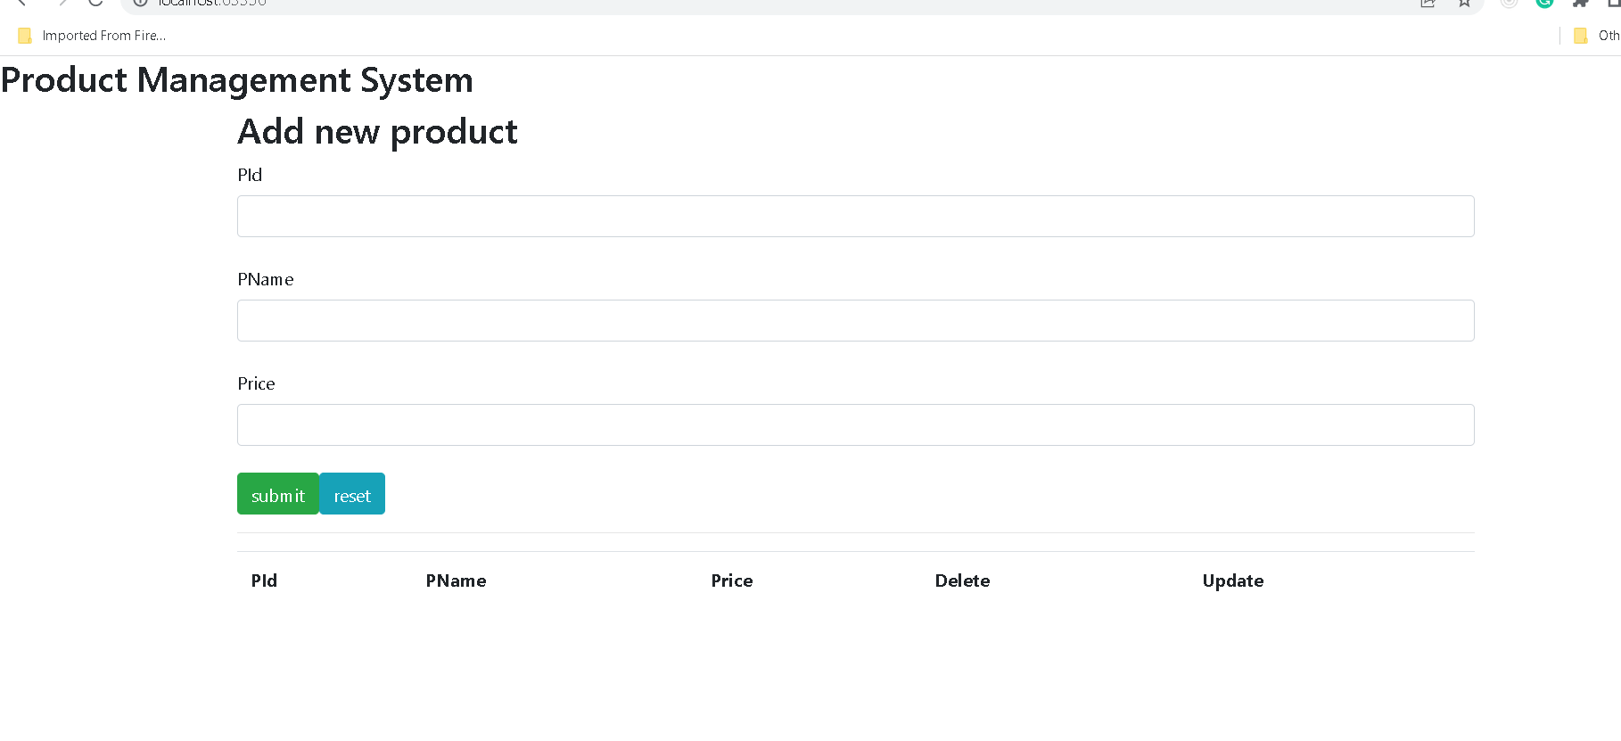

Slide 13
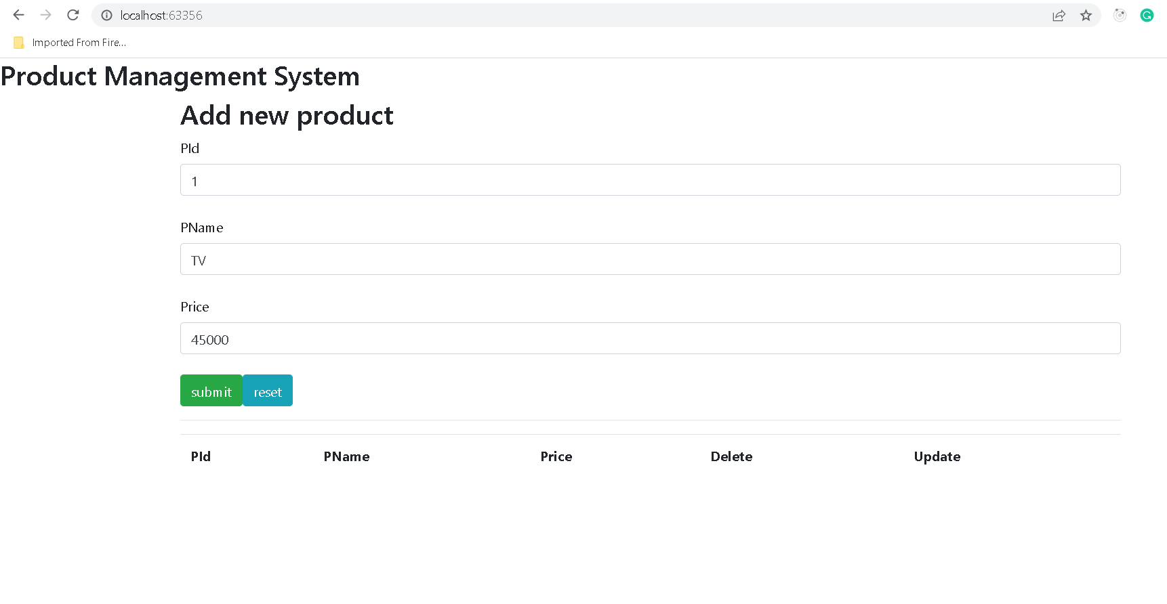

Slide 14
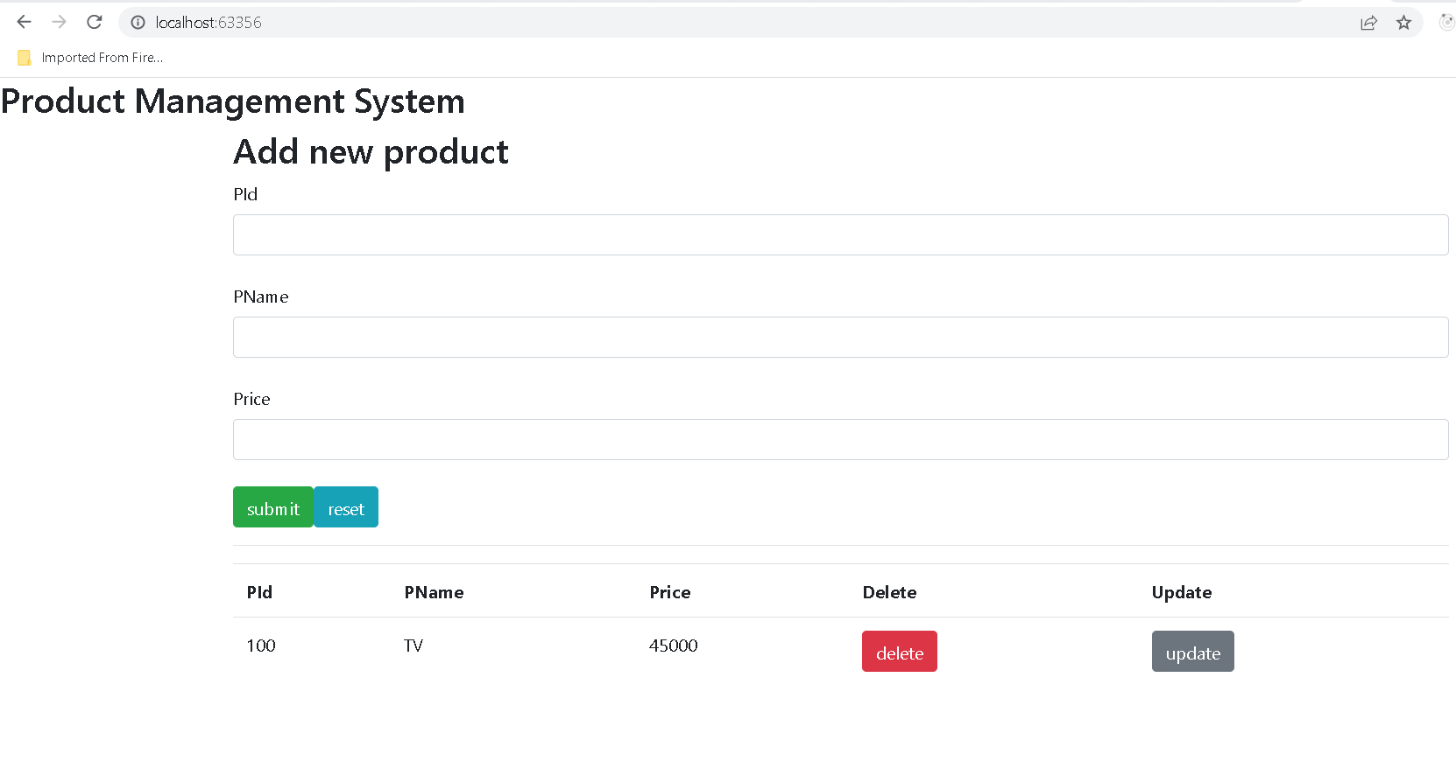

Slide 15
